Slide 1
I Got Transported to Another World and Got Married to a Vampire Shrimp but his Vampire Family Doesn't Approve of our Marriage
Systems Analysis Presentation
You can call us “IGTTAWAGMTAVSBHVFDAOUM” for short…
Presenter: Adam
Notes:
Title.

Slide 2
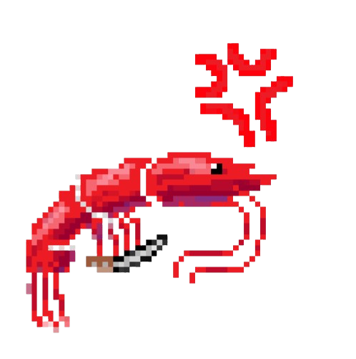

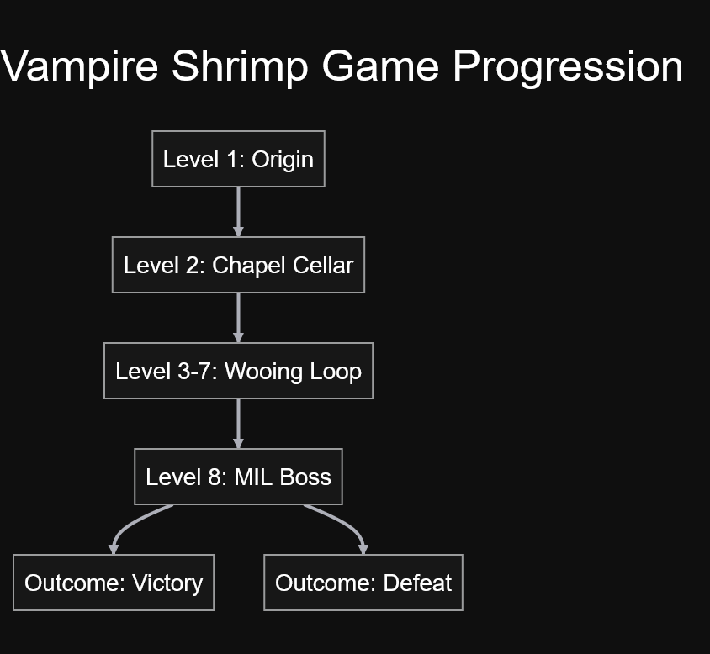
Intro
Presenter: Adam
Notes:
Welcome to The game! We can call it that for simplicity.
We’re making a video game that has rogue like and dating elements that merge together to tell a story about winning the approval of a stern vampire shrimp family.
Go from outcast who almost missed your own wedding…. That you didn’t know you were having …. To a respected member of the vampire shrimp family.
Follow a simple and awfully sweet gameplay loop, and, most importantly, have fun.

Slide 3
IGTTAWAGMTAVSBHVFDAOUM development team
TL1
Adam
TL2
Hayden
TL2+
Gagan
TL3
Shenghao
TL4
Michael
TL5
Wyatt
TL6
Nishant
Presenter: Adam
Notes:
This is the team that is powering this incredible creation.
We’ve got me, TL1 Adam.
Then we’ve got TL2 Hayden
We’ve also got a TL2+, Gagan.
Next we have our TL3, Shenghao.
After that, we’re onto our expert TL4, Michael.
Our TL5, Wyatt, is here to use AI…. Responsibly….
And, rounding out the team, we have TL6 Nishant.
Let’s get into the story.

Slide 4
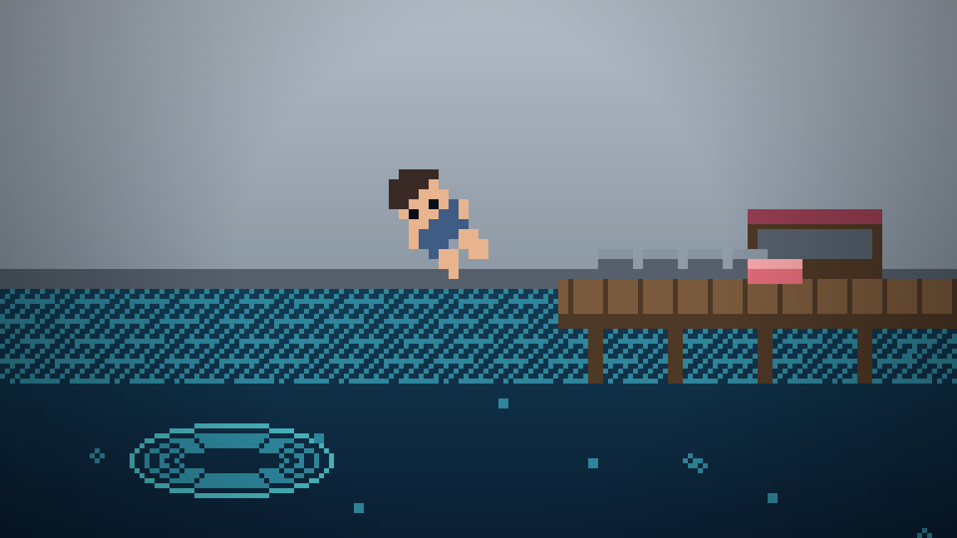
Story Board #1
Introductory Story Beat (Cutscene)
Presenter: Michael
Notes:
Transported to another world – how?
Person diving at night at a secluded beach.
Suddenly, bit by several vampire shrimp at once.
Loses consciousness, and drifts into a “dream world” where they just got married to a vampire shrimp

Slide 5
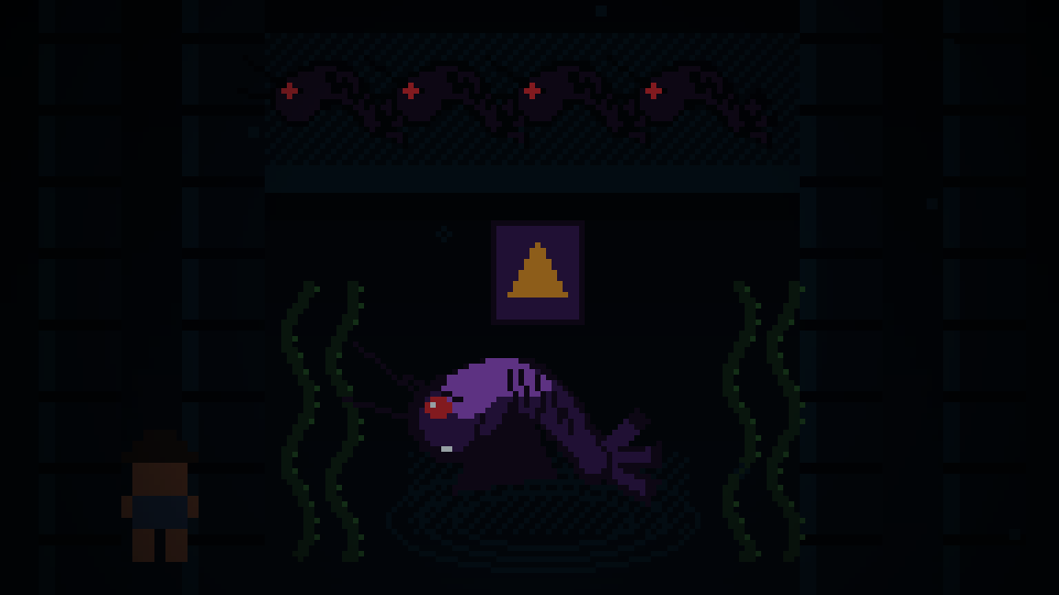
Story Board #2
Introductory Action Story Beat (Tutorial / Level 1)
Presenter: Michael
Notes:
Tutorial and Level One
You wake up in a haze in the cellar of a chapel (setting).
Then, this is the tutorial: learn controls and simple fighting - get out of the cellar)
Play initial level one, getting out of the basement, in order to get to the Ceremony

Slide 6
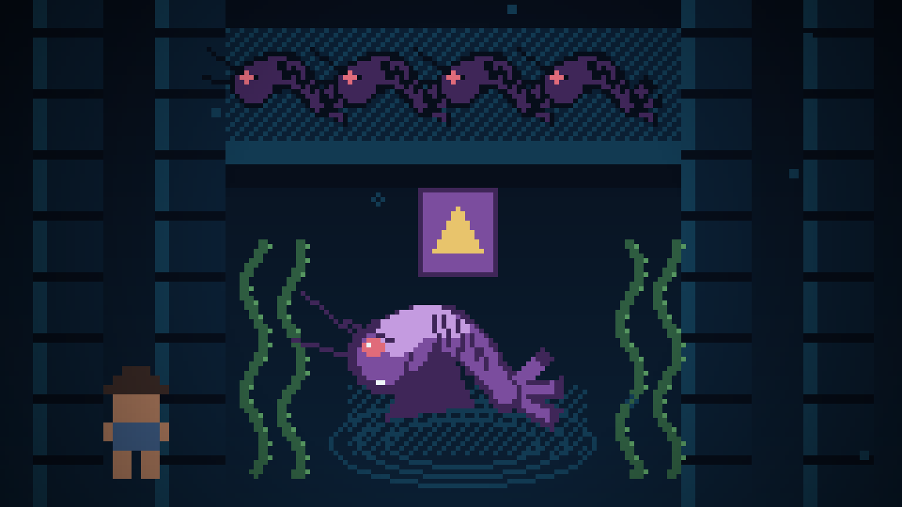
Story Board #3
Turning Point – Late to Your Own Wedding; Family Disapproval (Level 2)
Presenter: Michael
Notes:
Transition point – this is the ceremony and what follows directly after.
You’re late to your own vampire shrimp wedding.
The marriage is official, even if the family disapproves.
Your vampire shrimp spouse isn’t permitted to go home with you, you’re out on the street in front of the chapel and you need to prove your worth to the family.
This scene takes you to a shop where you purchase weapons and items.
After this point you go onto level 2, which is a bridge to level 3.
************************* INTRA-TEAM NOTES – NOT FOR CLASS DISCUSSION *******************************
Level 2 is a bridge to level 3, a simple level that takes you across town, for example, where you pick up a quest, or hear a rumor, about something that can put you back into the family’s good graces.
AFTER THIS POINT, IF YOU DIE, WE MUST PLAY THE DEATH SCENE (Good Riddance – Shrimp Family) (Player was never seen again…. Drowned)

Slide 7
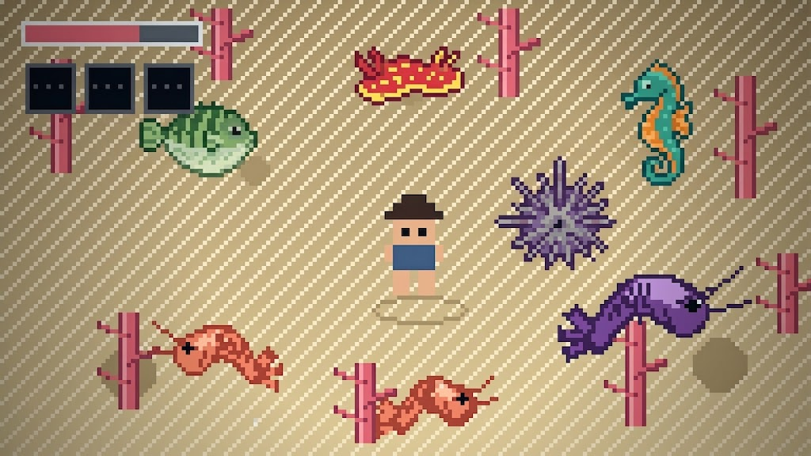
Story Board #4
Geared up, and ready to prove your worth. (Level 3)
Presenter: Michael
Notes:
Rising Action – Level Three. You’re ready to start dating the vampire shrimp in your spouse’s family, and gain their trust. Unfortunately, enemies and sea hazards stand between you and each family member.
We’re going to say that this is very much approved in vampire shrimp culture.
You are now in the main gameplay loop, where you begin fighting waves of enemies to get to the members of your shrimp family.
Get familiar with buying new weapons, and upgrading during rounds.
************************* INTRA-TEAM NOTES – NOT FOR CLASS DISCUSSION *******************************
Leve 2 is a bridge to level 3, a simple level that takes you across town, for example, where you pick up a quest, or hear a rumor, about something that can put you back into the family’s good graces.

Slide 8
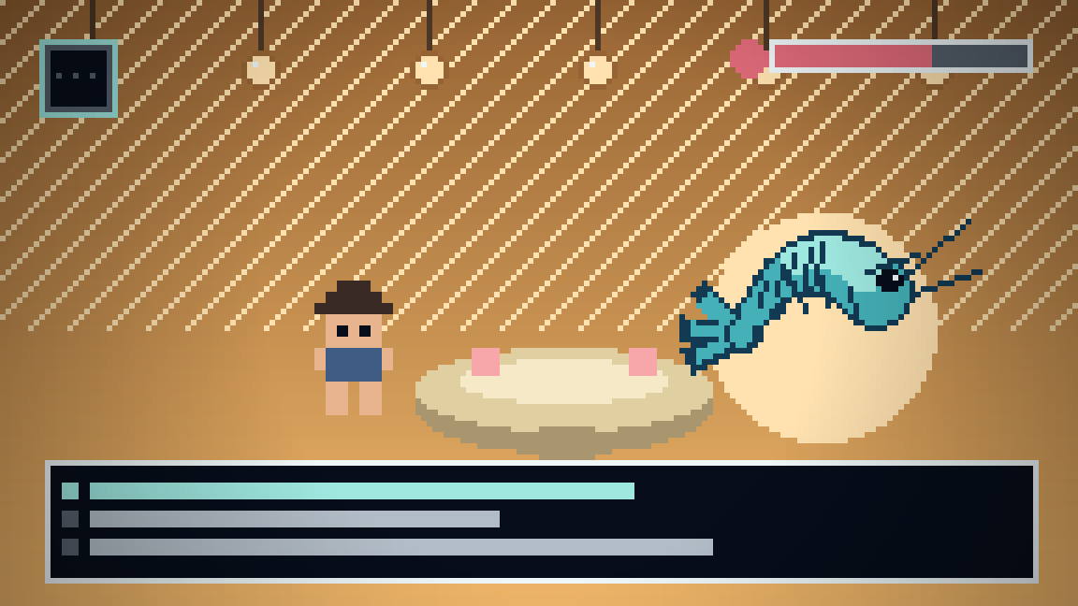
Story Board #5
Dating the family members and becoming well-liked.
Presenter: Michael
Notes:
At this point, you’ve defeated the hordes and are ready to date one of the family members.
Be sure to successfully woo enough family members.
Without them, the next levels will be harder, and you may not be liked enough to get approval for your marriage.

Slide 9
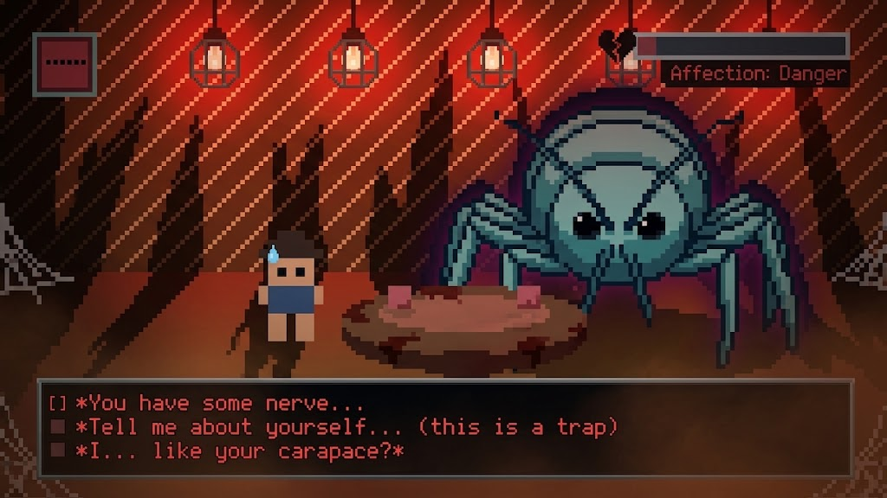
Story Board #6
The Final Boss, And Approval?
Presenter: Michael
Notes:
In Story board section 6, we’re completing level 8 and overcoming the final hurdle. You’ve made a great effort so far to win the approval of family members, but was it enough?
Once we are able to woo the mother in law, our spouse’s family will approve of the Vampire Shrimp marriage!
Should you fail… you may wind up back at the beginning of your long journey.

Slide 10
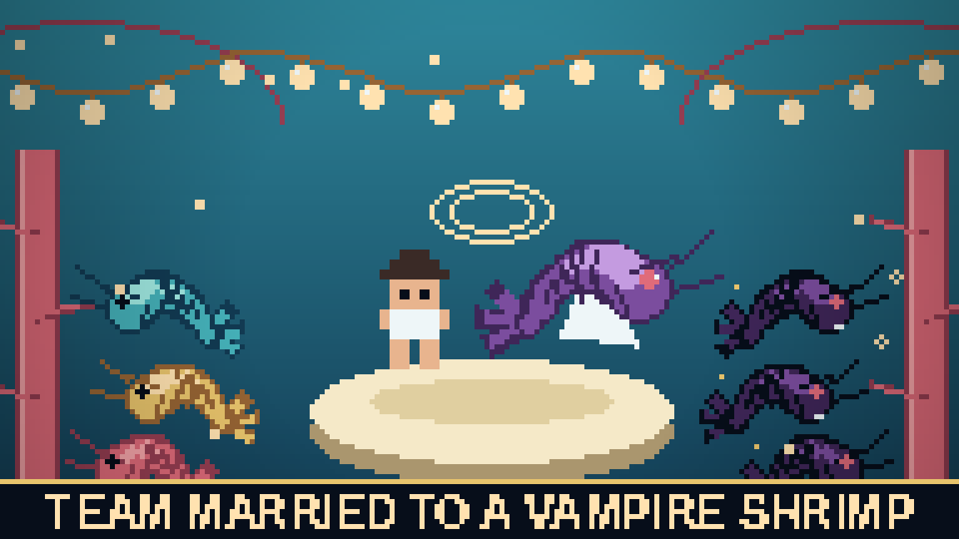
Story Board #7
Finally, approval from the family.
Presenter: Michael
Notes:
And now we’ve reached the end.
You’ve successfully wooed enough family members, and appeased the mother in law.
That makes you the victor of this game! Enjoy your life as the partner of a vampire shrimp.
….You might be stuck here…. Uh… Forever…
We’re now going to transition towards the Context Diagram and Diagram 0 for this project.

Slide 11
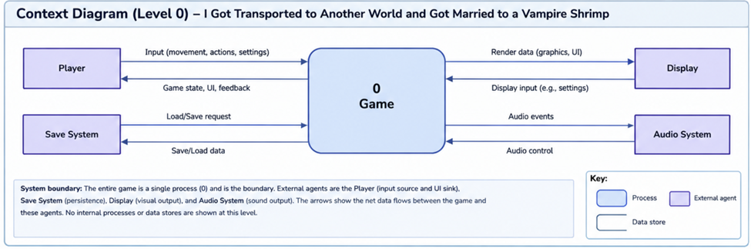
Context Diagram
Presenter: Wyatt

Slide 12
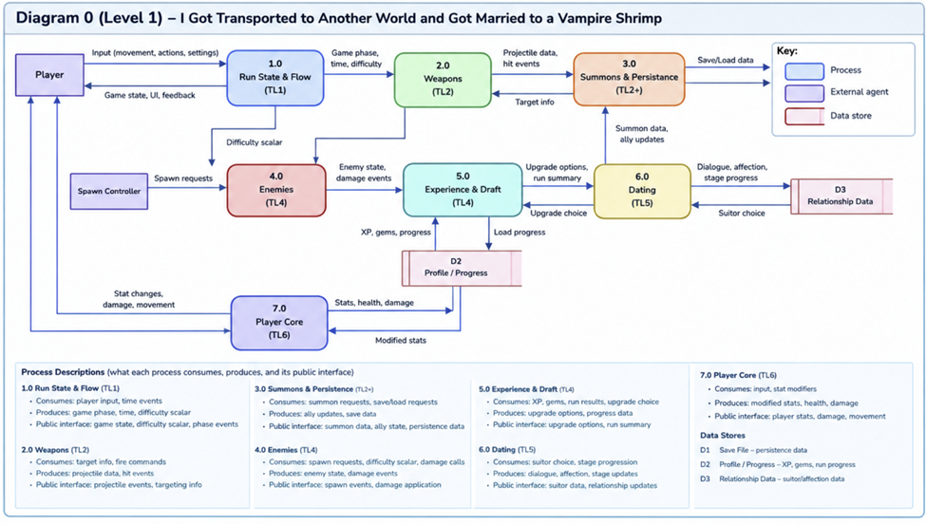
Diagram 0
Presenter: Wyatt

Slide 13
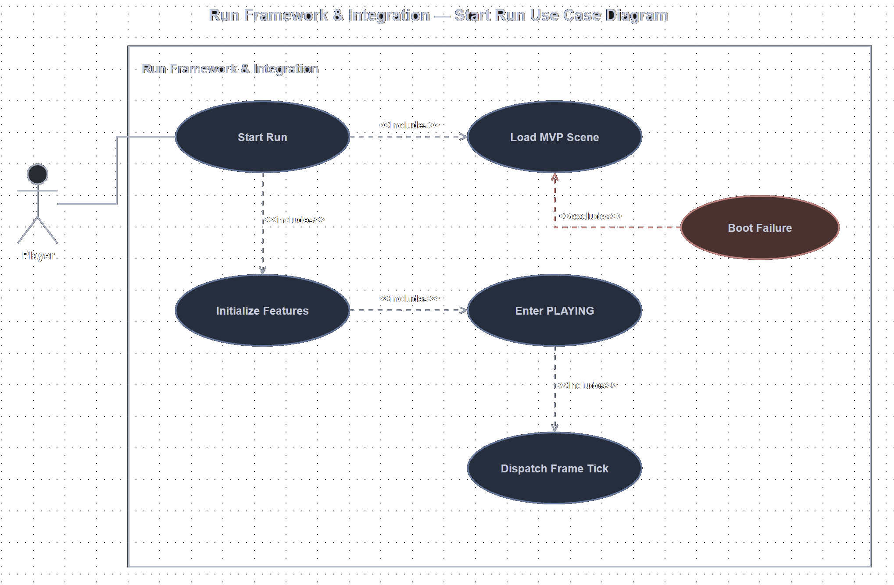
TL1: Adam - Use Case Diagram
Presenter: Adam
Notes:
NOTE – This diagram needs refactored.

Slide 14
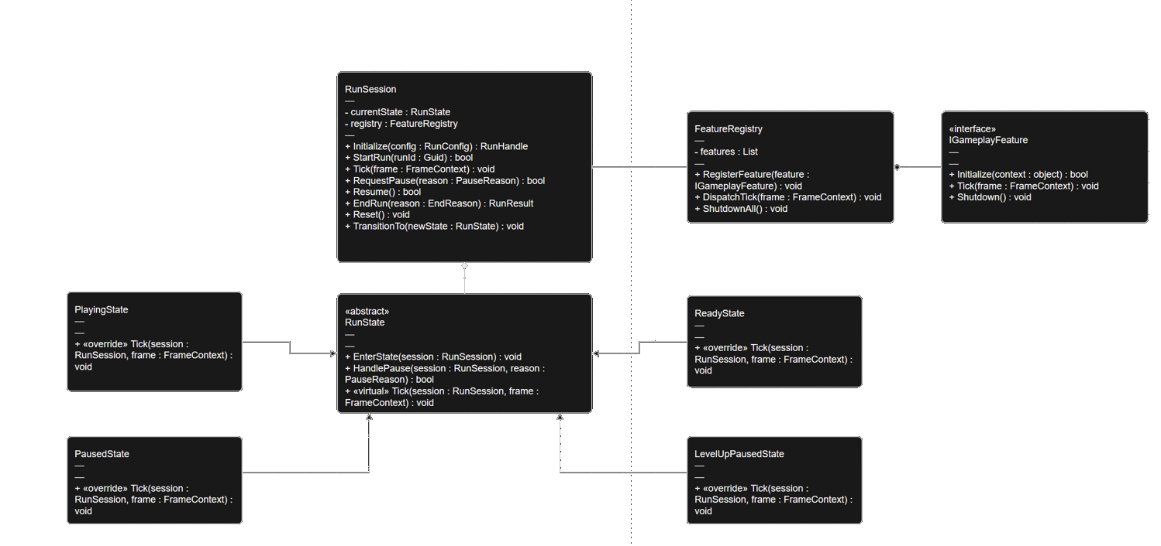
TL1: Adam - Class Diagram
Presenter: Adam

Slide 15
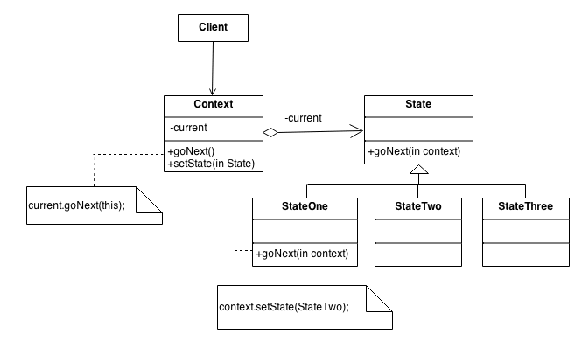
TL1: Adam - Class Diagram – State Design Pattern
Presenter: Adam
Notes:
My Class Diagram demonstrates a pattern in line with the Gang of Four as shown.
The client role is taken by the Unity Game Loop / Composition root – It triggers high-level calls on the context to manage the game lifecycle.
The context role is taken by RunSession, which holds the active current state reference, and exposes critical operations like Ticks / game updates, and the ability for other functions to request a pause of the game, or fetch the current state, for example.
The state role is taken by the RunState feature class, which is an abstract base class that defines state specific operations (Handling pauses, handling the running session information, etcetera)
Lastly, the States themselves, taken by the PlayingState, PausedState, LevelUpPausedState, etcetera, are concrete state subclasses that inherit from runstate and override state-specific behavior.
Reference:
https://sourcemaking.com/design_patterns/strategy

Slide 16
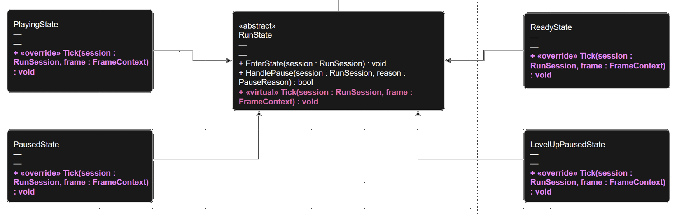
TL1: Adam - Class Diagram – Dynamic Binding
Presenter: Adam
Notes:
-------------------- What I’m saying now: ---------------------
RunState rs = new ReadyState;
RunState is the static type. – This “rs” variable will always be a RunState.
ReadyState is the dynamic type. – It can change while the program is running.
Because Tick is virtual, if you do rs.Tick(), it will run the tick in ReadyState.
-------------------- Notes for the future ---------------------
** IN THE ORAL EXAM, WE WILL REMOVE KEYWORDS VIRTUAL AND OVERRIDE **
** THAT WILL RUN THE TICK IN RUNSTATE, BASICALLY, WE ARE DISABLING THE OVERRIDES, AND FORCING THE TICK BACK TO THE RUNSTATE **
-> Bind based on the static type, so we’ll look for Tick to be defined in the statictype, which is RunState.

Slide 17
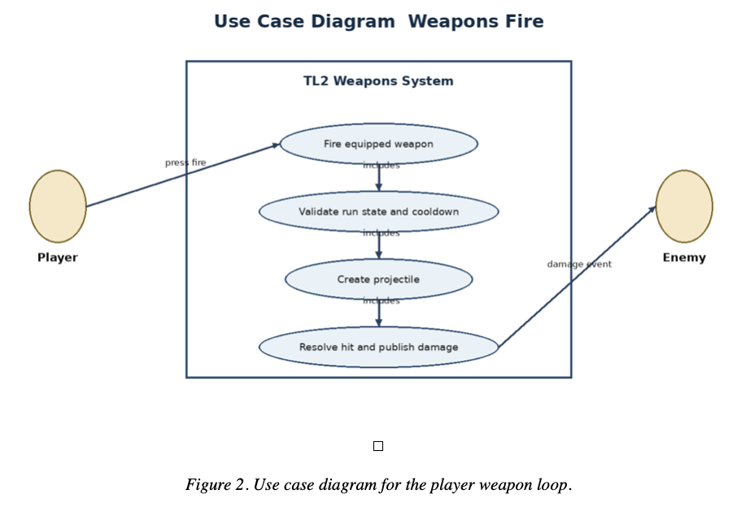
TL2: Hayden – Use Case Diagram
Presenter: Hayden

Slide 18
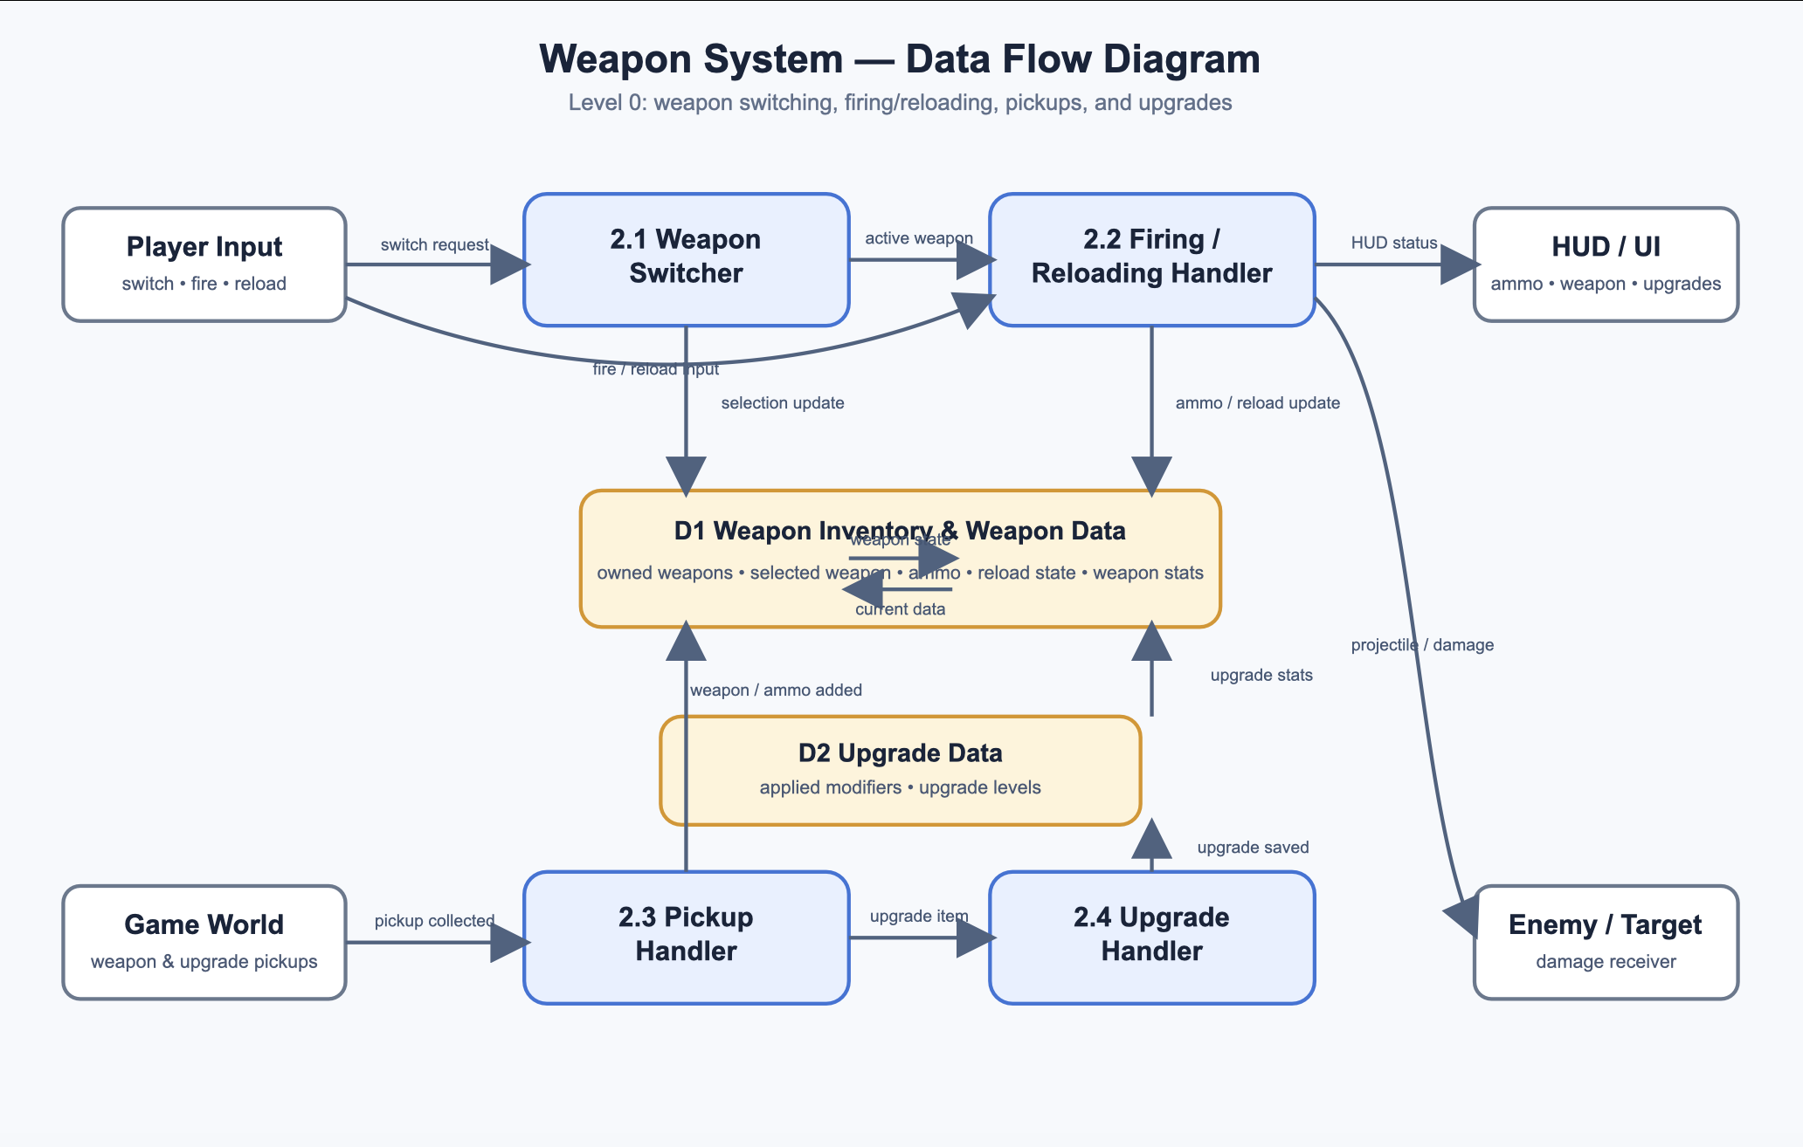
TL2: Hayden – Class Diagram
Presenter: Hayden

Slide 19
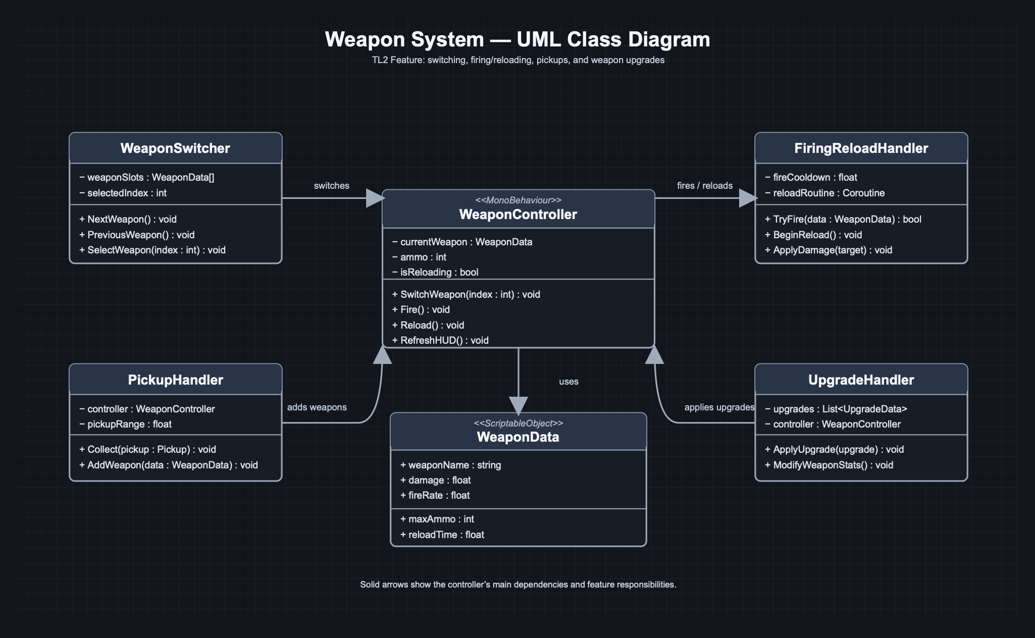
TL2: Hayden – State Design Pattern
Presenter: Hayden

Slide 20
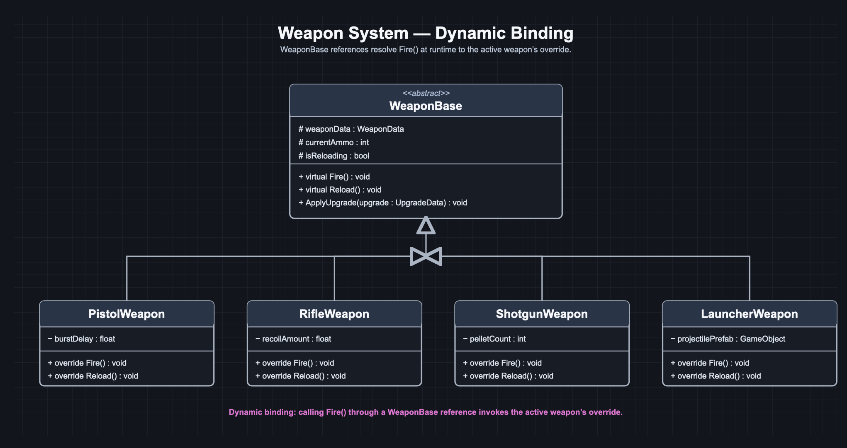
TL2: Hayden – Dynamic Binding
Presenter: Hayden

Slide 21
TL2+: Gagan – Use Case Diagram
Presenter: Gagan

Slide 22
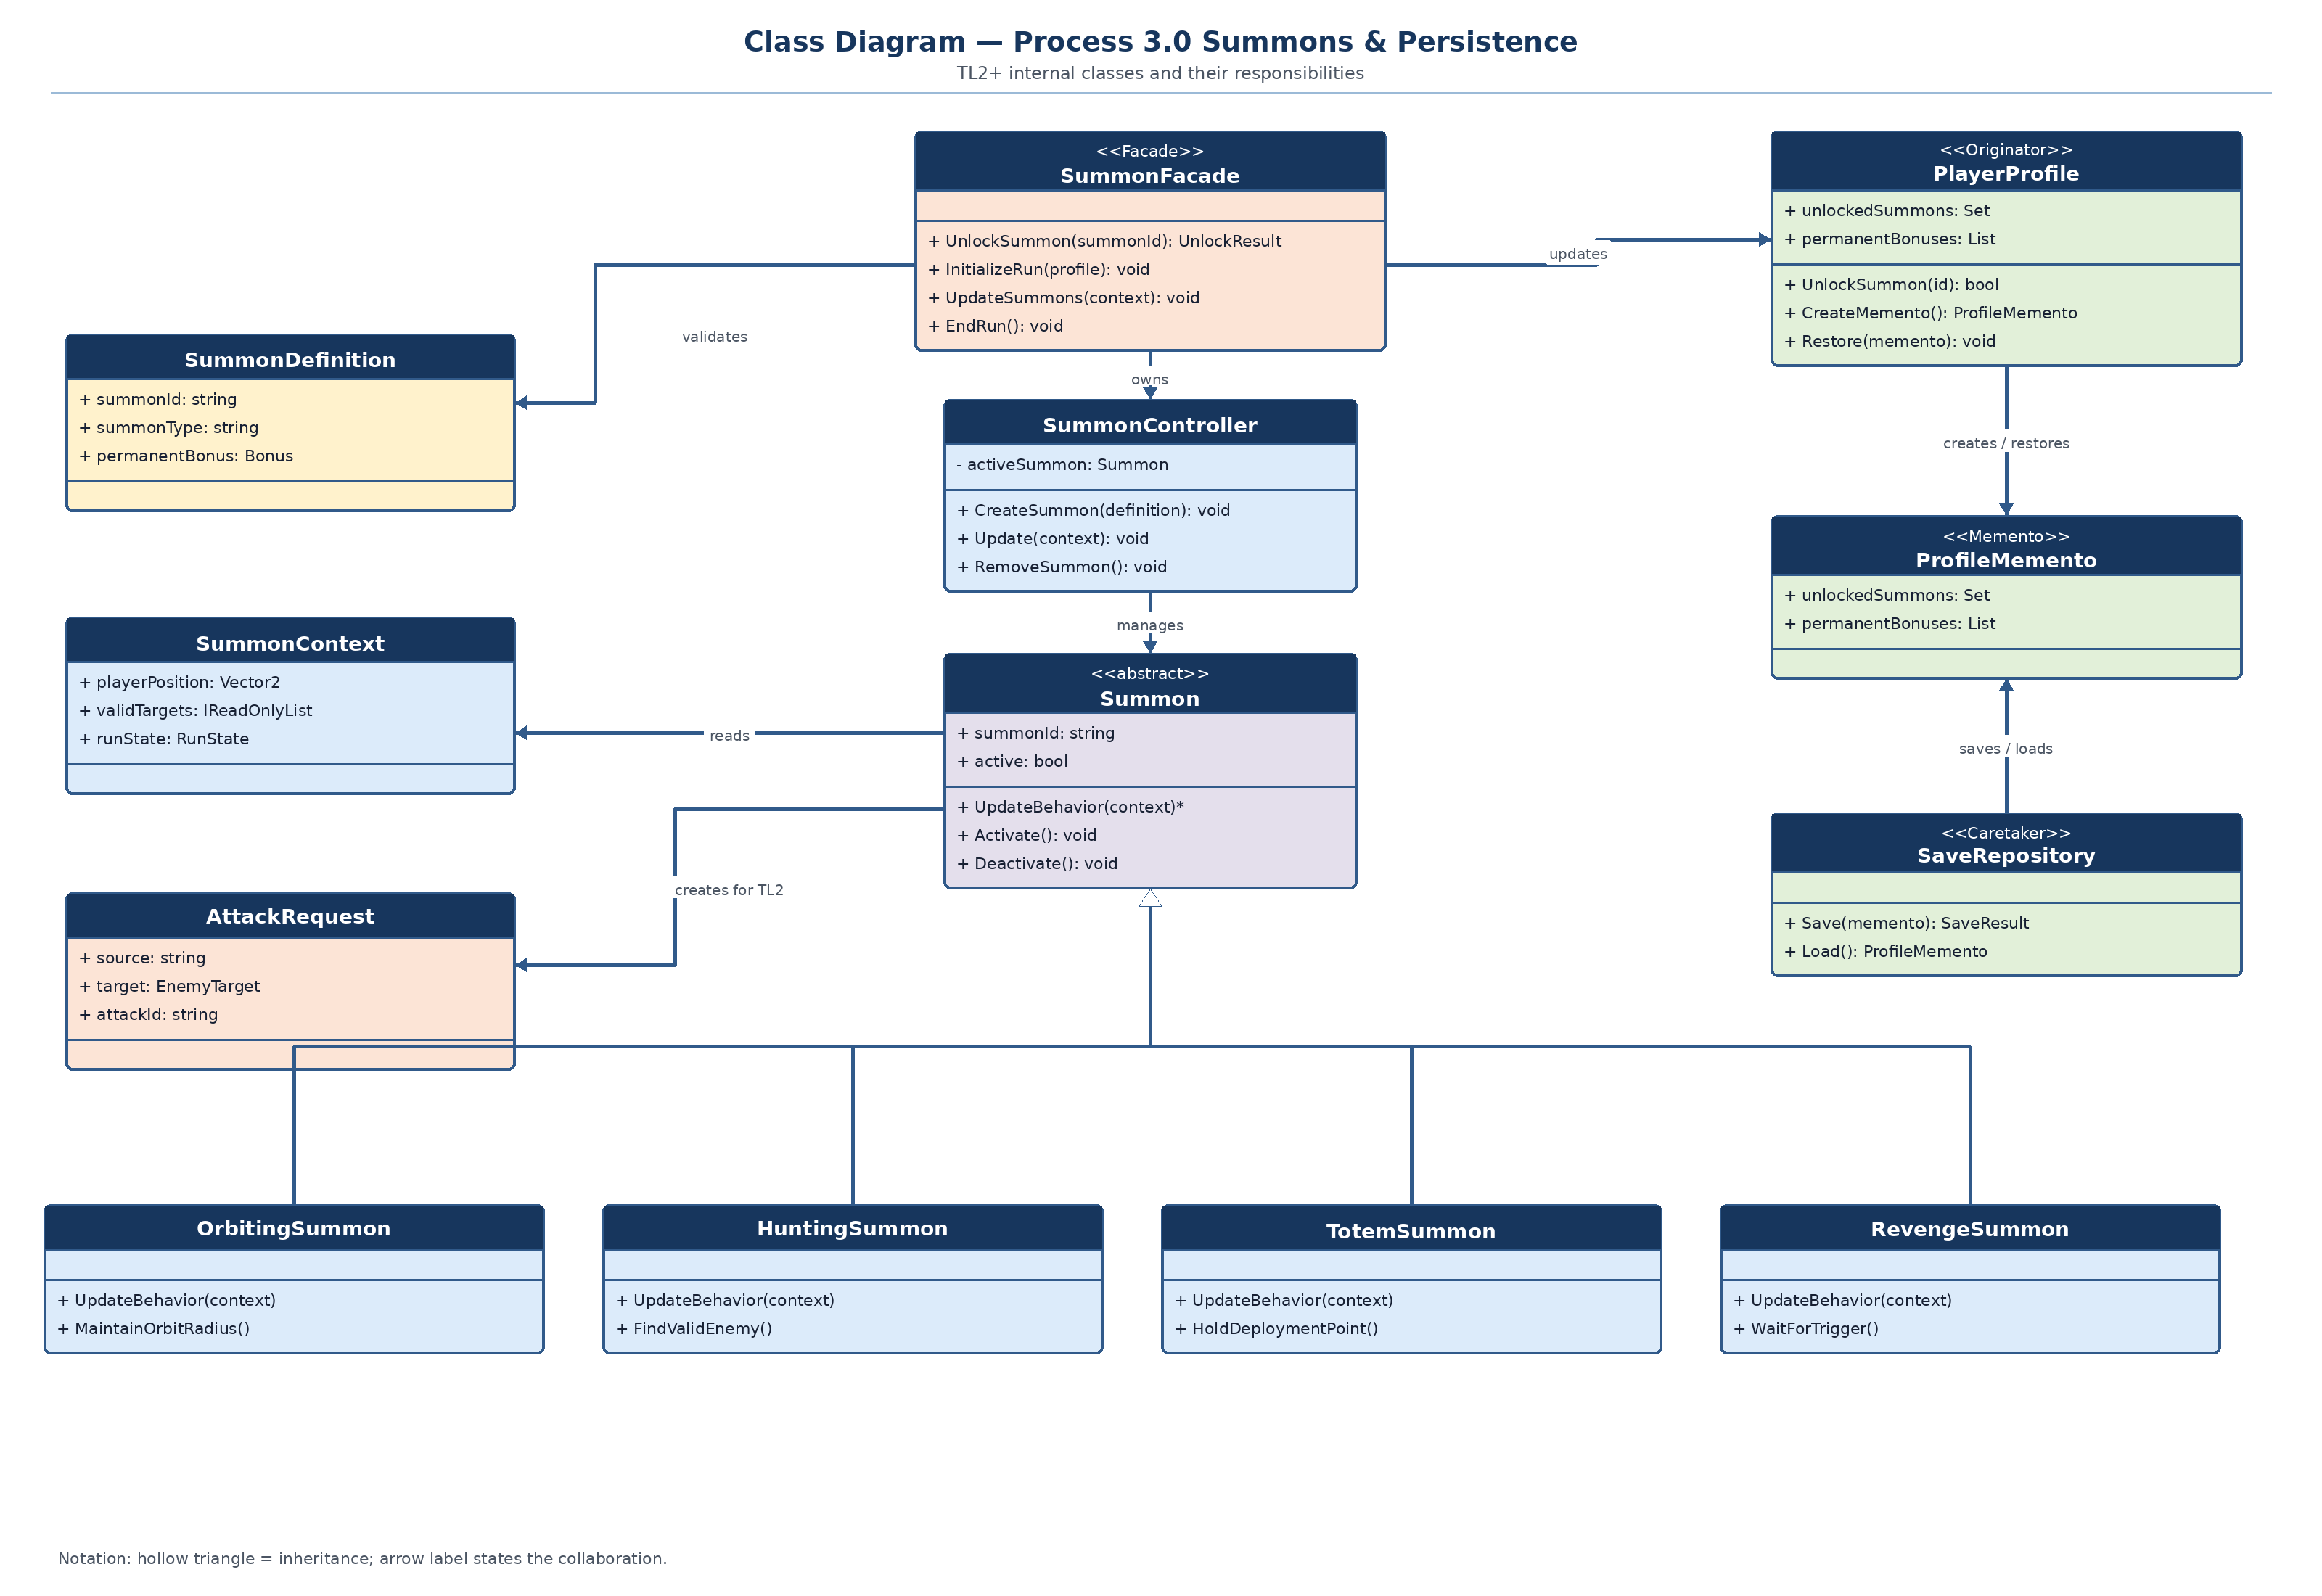
TL2+: Gagan – Class Diagram
Presenter: Gagan

Slide 23
TL2+: Gagan – State Design Pattern
Presenter: Gagan

Slide 24
TL2+: Gagan – Dynamic Binding
Presenter: Gagan

Slide 25
TL3: Shenghao - Enemy Use Case
Run Framework
Enemy Spawn & AI
Difficulty and
spawn requests
Spawn enemies
Player
Chase player
Damage events
and XP reward
Resolve defeat
Presenter: Shenghao
Notes:
The run framework initializes and ticks the enemy feature. The director spawns enemies using a difficulty input. An enemy moves toward the player and reports contact damage. On defeat it reports a reward to the XP feature. These are proposed behaviors from the team data flow diagram.

Slide 26
TL3: Shenghao - Enemy Class Diagram (State Pattern)
EnemySystem
SpawnDirector
Enemy
- active: List<Enemy>
+ Tick(frame): void
- timer: float
+ Spawn(): Enemy
- health: int
- state: EnemyState
+ Tick(dt): void
+ SetState(next): void
holds current state
EnemyState (abstract)
+ Enter(enemy): void
+ Tick(enemy, dt): void
inherits from
ChaseState
AttackState
DeadState
+ Tick(): follow player
+ Tick(): contact damage
+ Tick(): report defeat
Presenter: Shenghao
Notes:
The State pattern is visible in this first class diagram. Enemy holds an EnemyState reference and delegates Tick to the current state. ChaseState, AttackState, and DeadState inherit from EnemyState and override behavior. EnemySystem manages enemies and SpawnDirector creates them. The state choices are proposed and should be aligned with the implementation.

Slide 27
TL3: Shenghao - Enemy State Pattern
Enemy
EnemyState (abstract)
- state: EnemyState
+ Tick(dt): state.Tick(this, dt)
+ SetState(next): void
+ Enter(enemy): void
+ Tick(enemy, dt): void
+ Exit(enemy): void
ChaseState
AttackState
DeadState
Move toward the player
Switch when health reaches zero
Apply contact damage
Return to chase if out of range
Stop movement
Report defeat exactly once
Presenter: Shenghao
Notes:
The Enemy context delegates each frame to its current EnemyState. ChaseState moves toward the player, AttackState applies contact damage, and DeadState reports defeat once. The state transitions are illustrative design choices and should be confirmed with implementation.

Slide 28
TL3: Shenghao - Dynamic Binding
One EnemyState reference invokes different behavior at runtime
EnemyState
ChaseState
AttackState
+ virtual Tick(enemy, dt): void
+ override Tick(enemy, dt)
Move toward player
+ override Tick(enemy, dt)
Apply contact damage
EnemyState state = currentState; state.Tick(enemy, deltaTime);
The active state decides which override runs.
Presenter: Shenghao
Notes:
Enemy holds a reference typed as EnemyState. Calling state.Tick dynamically dispatches to ChaseState or AttackState based on the concrete object. This is the dynamic binding example associated with the proposed State pattern.

Slide 29
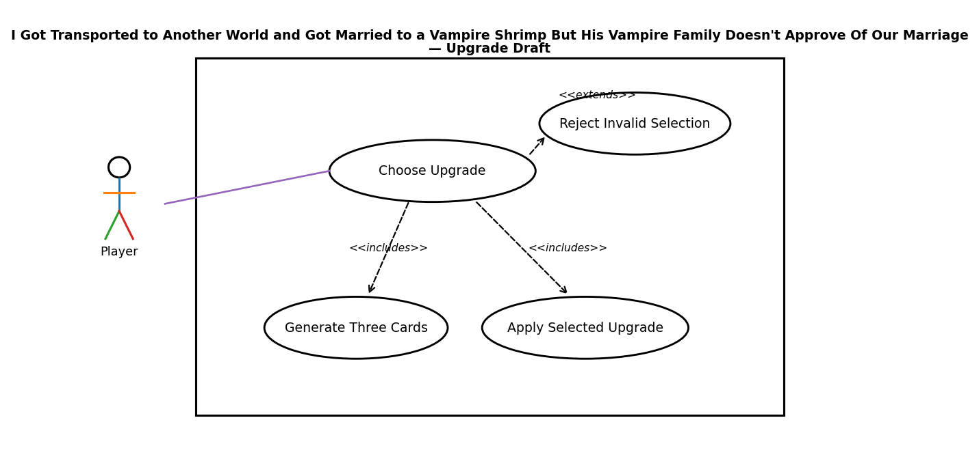
TL4: Michael – Use Case Diagram
Presenter: Michael

Slide 30
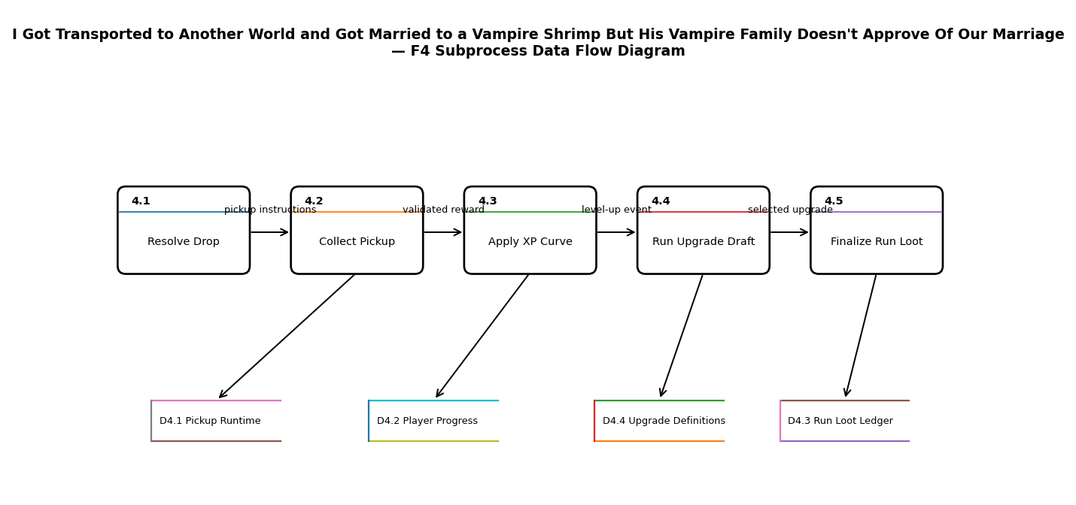
TL4: Michael – Class Diagram
Presenter: Michael

Slide 31
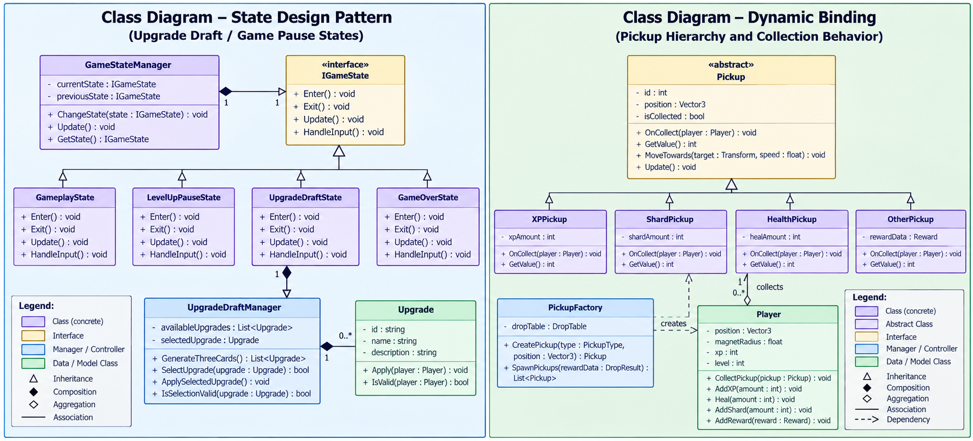
TL4: Michael – State Design Pattern
Presenter: Michael

Slide 32
TL4: Michael – Dynamic Binding
Presenter: Michael

Slide 33
TL5: Wyatt – Use Case Diagram
Presenter: Wyatt

Slide 34
TL5: Wyatt
Presenter: Wyatt

Slide 35
TL5: Wyatt
Presenter: Wyatt

Slide 36
TL5: Wyatt
Presenter: Wyatt

Slide 37
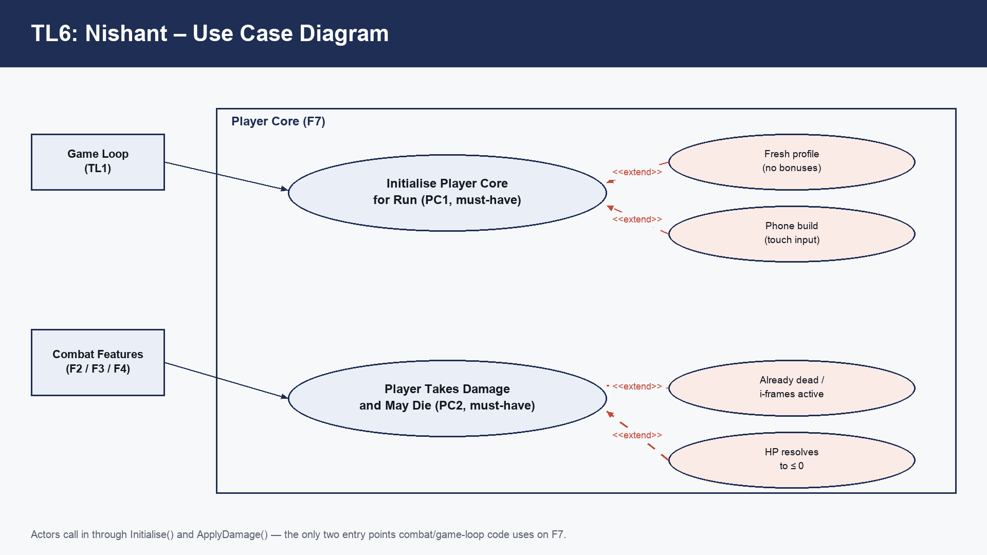
TL6: Nishant – Use Case Diagram
Presenter: Nishant

Slide 38
TL6: Nishant – Class Diagram
Presenter: Nishant

Slide 39
TL6: Nishant – Class Diagram (State Design Pattern)
Presenter: Nishant

Slide 40
TL6: Nishant – Class Diagram (Dynamic Binding)
Presenter: Nishant

